Slide 1
Project update
Evolutionary Algorithm Generator for Controlling Strategies of a Batbot
安武
2024/03/15

Slide 2
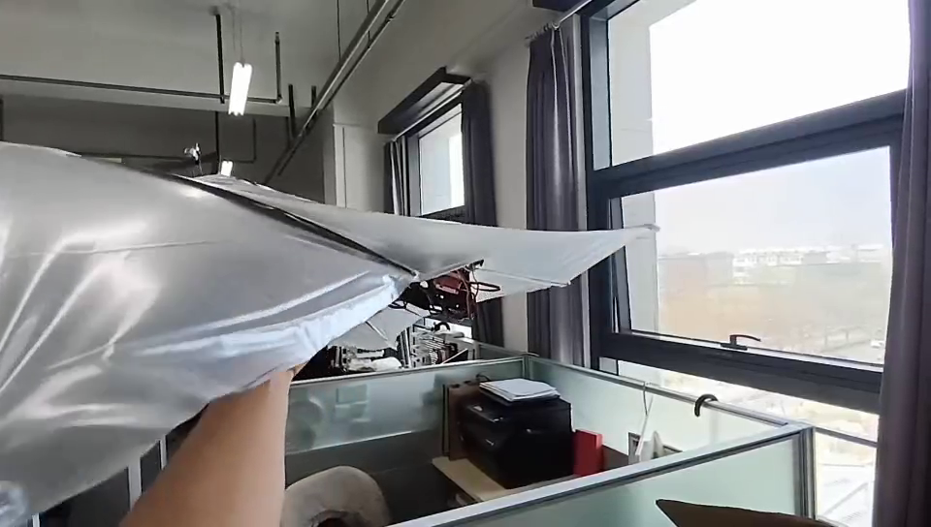
Research progress and problems encountered
Developed working feedback control using PID and MPU Sensor
1

Slide 3
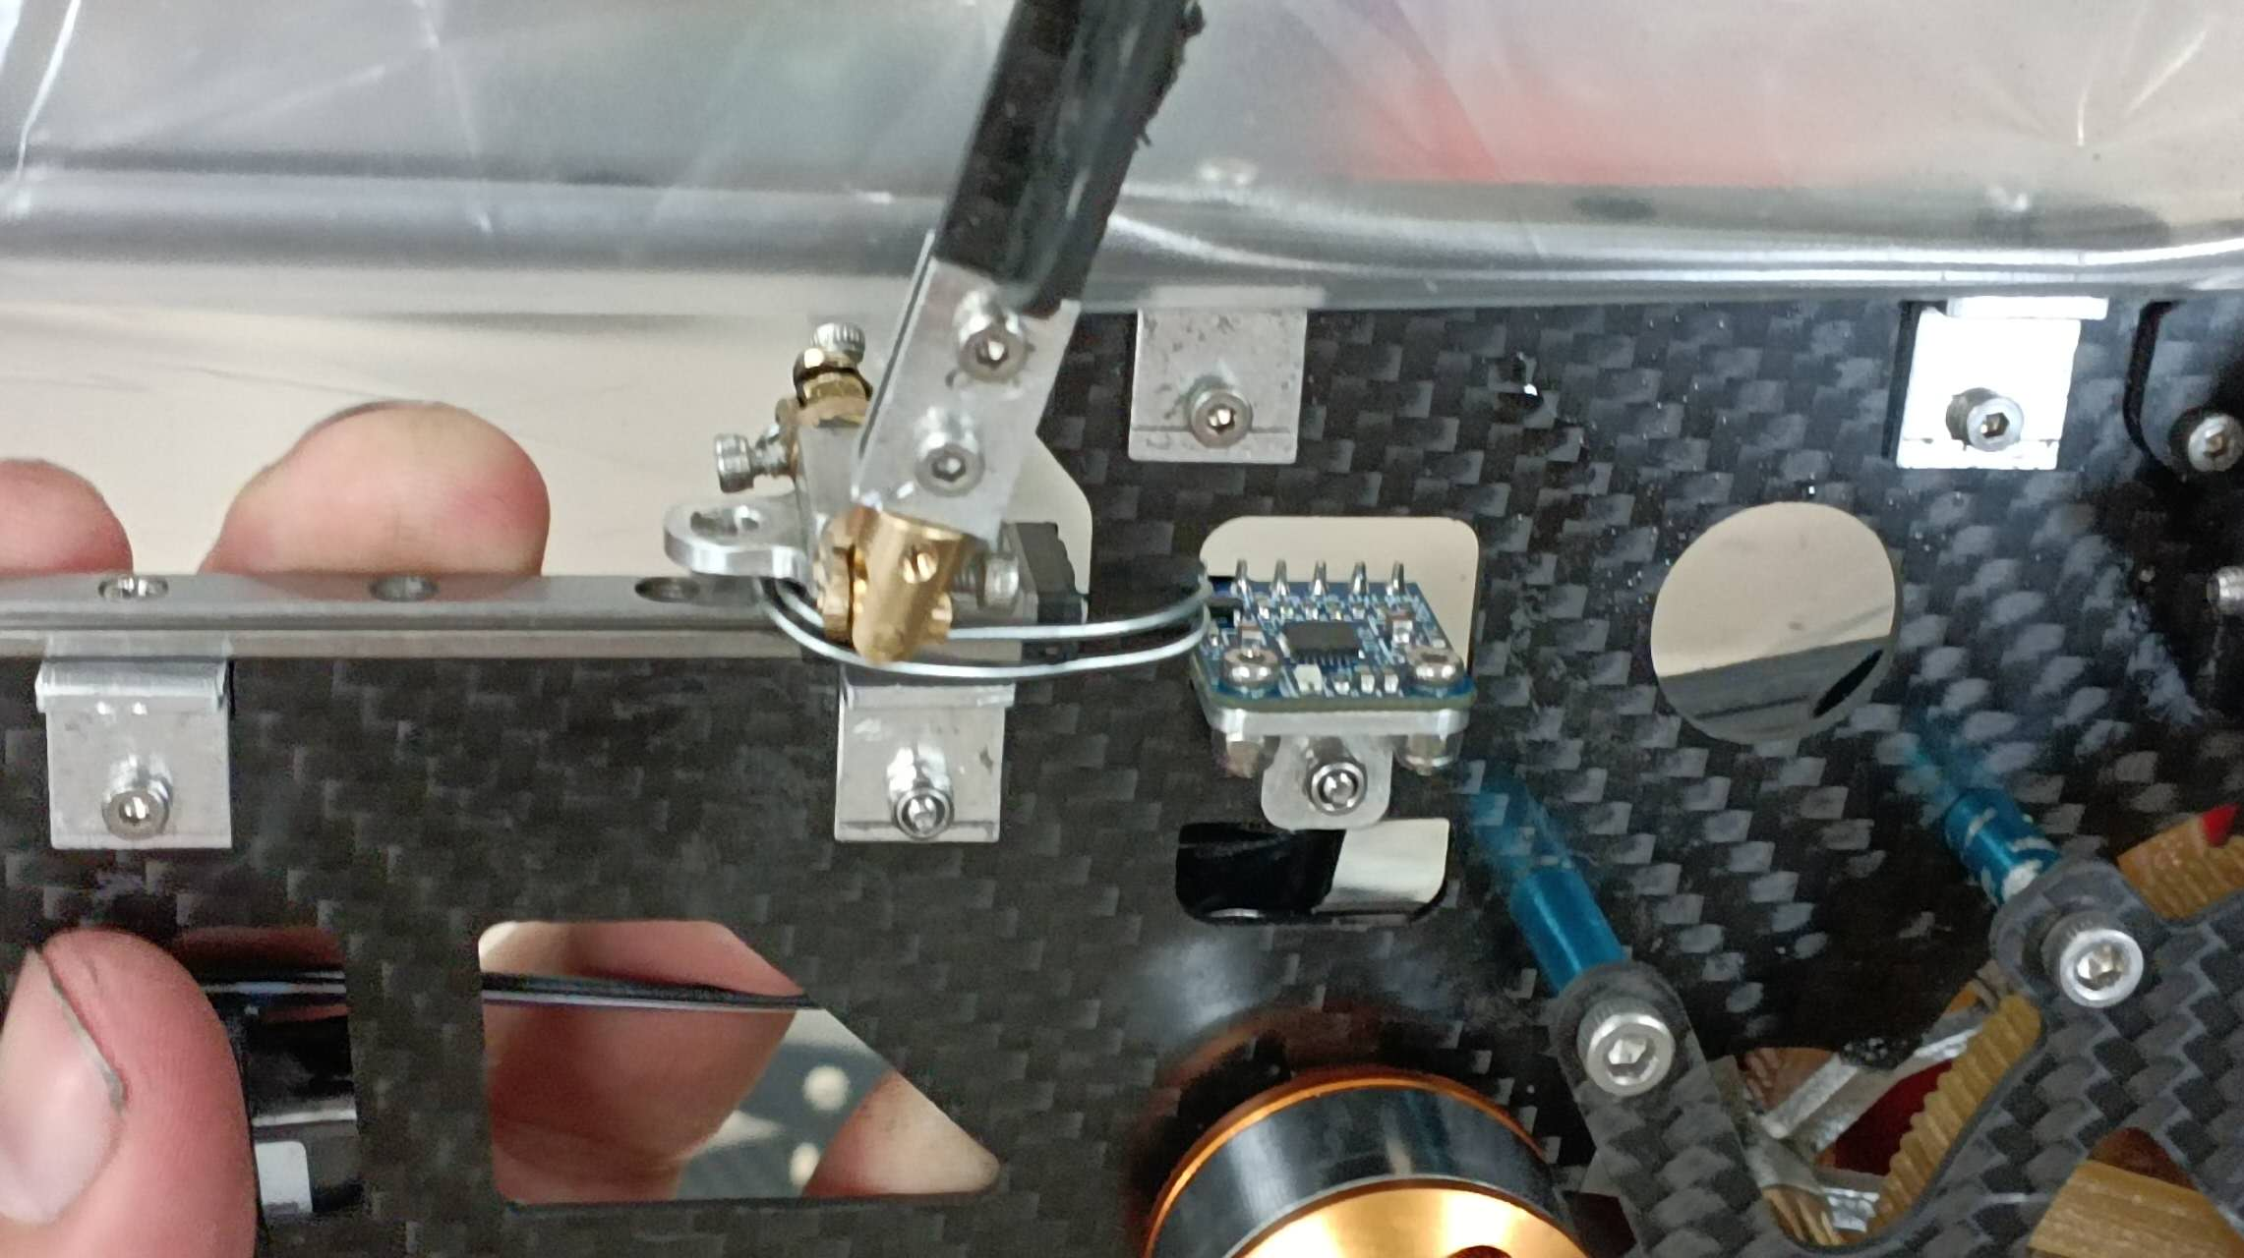
Research progress and problems encountered
To avoid vibrations:
Smoothing algorithm
Sensor fixation in body
2

Slide 4
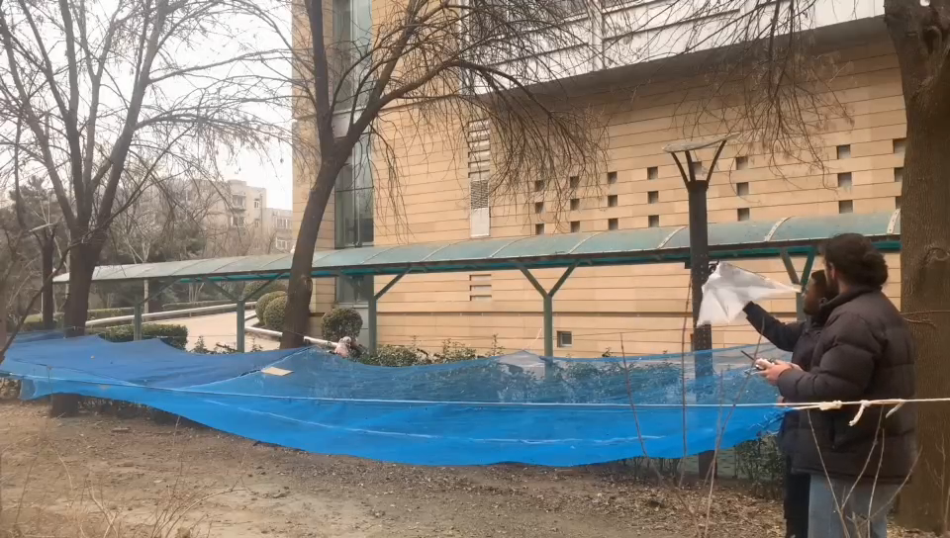
Research progress and problems encountered
3

Slide 5
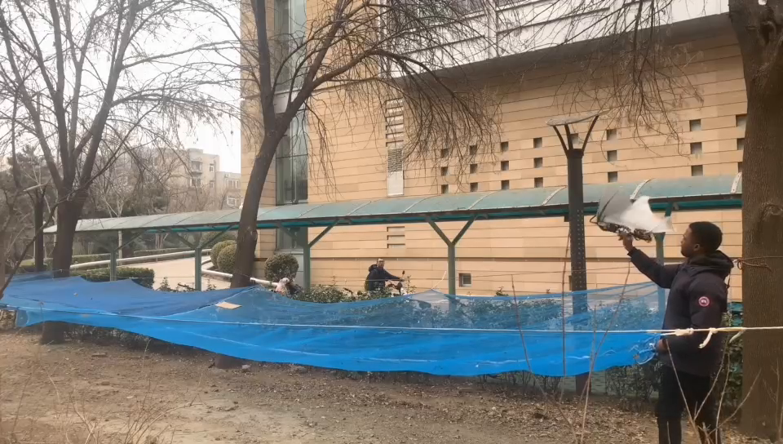
Research progress and problems encountered
4

Slide 6
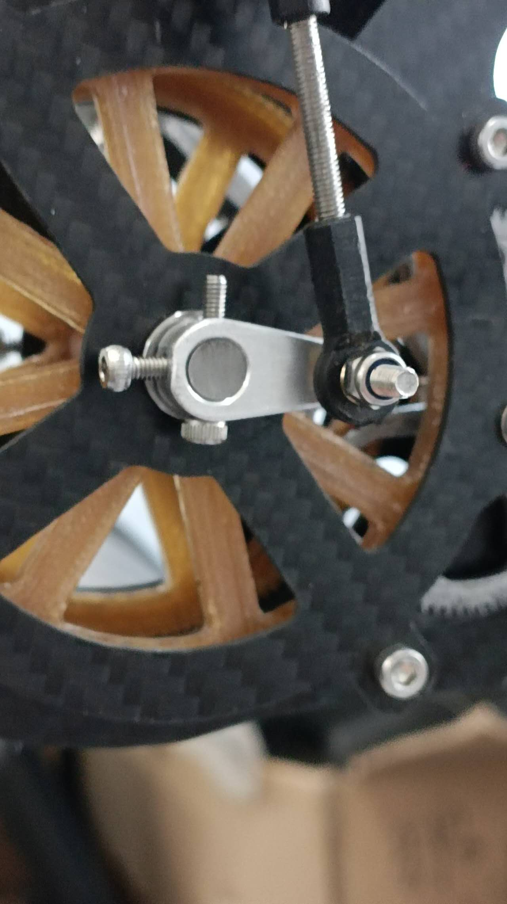
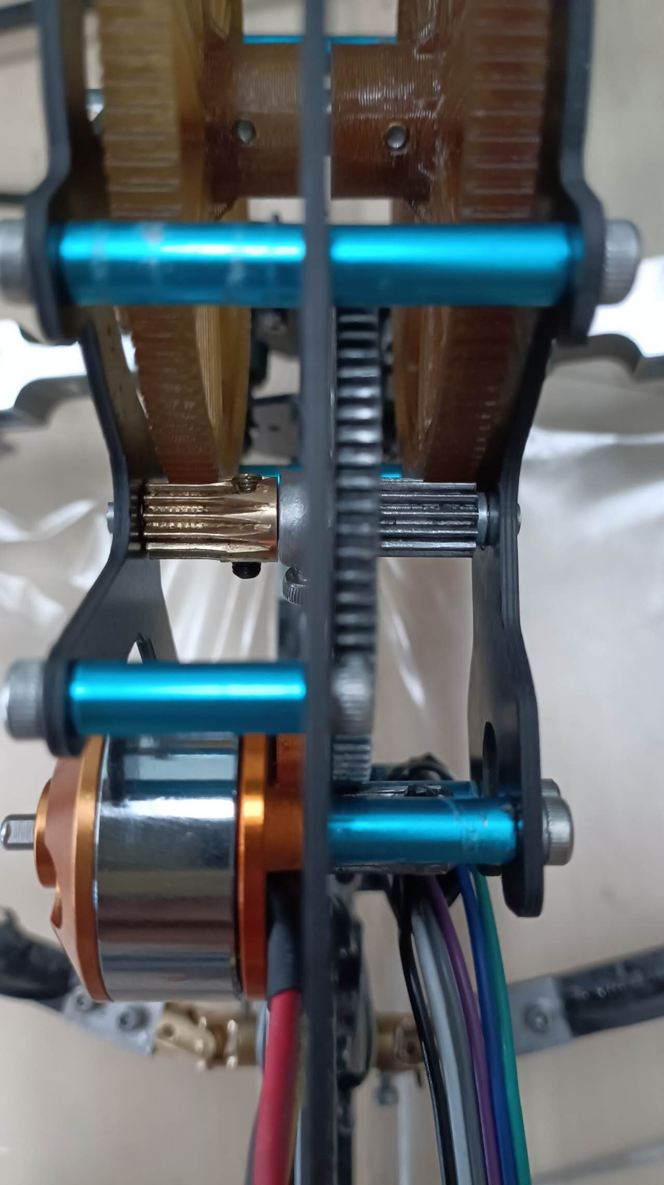
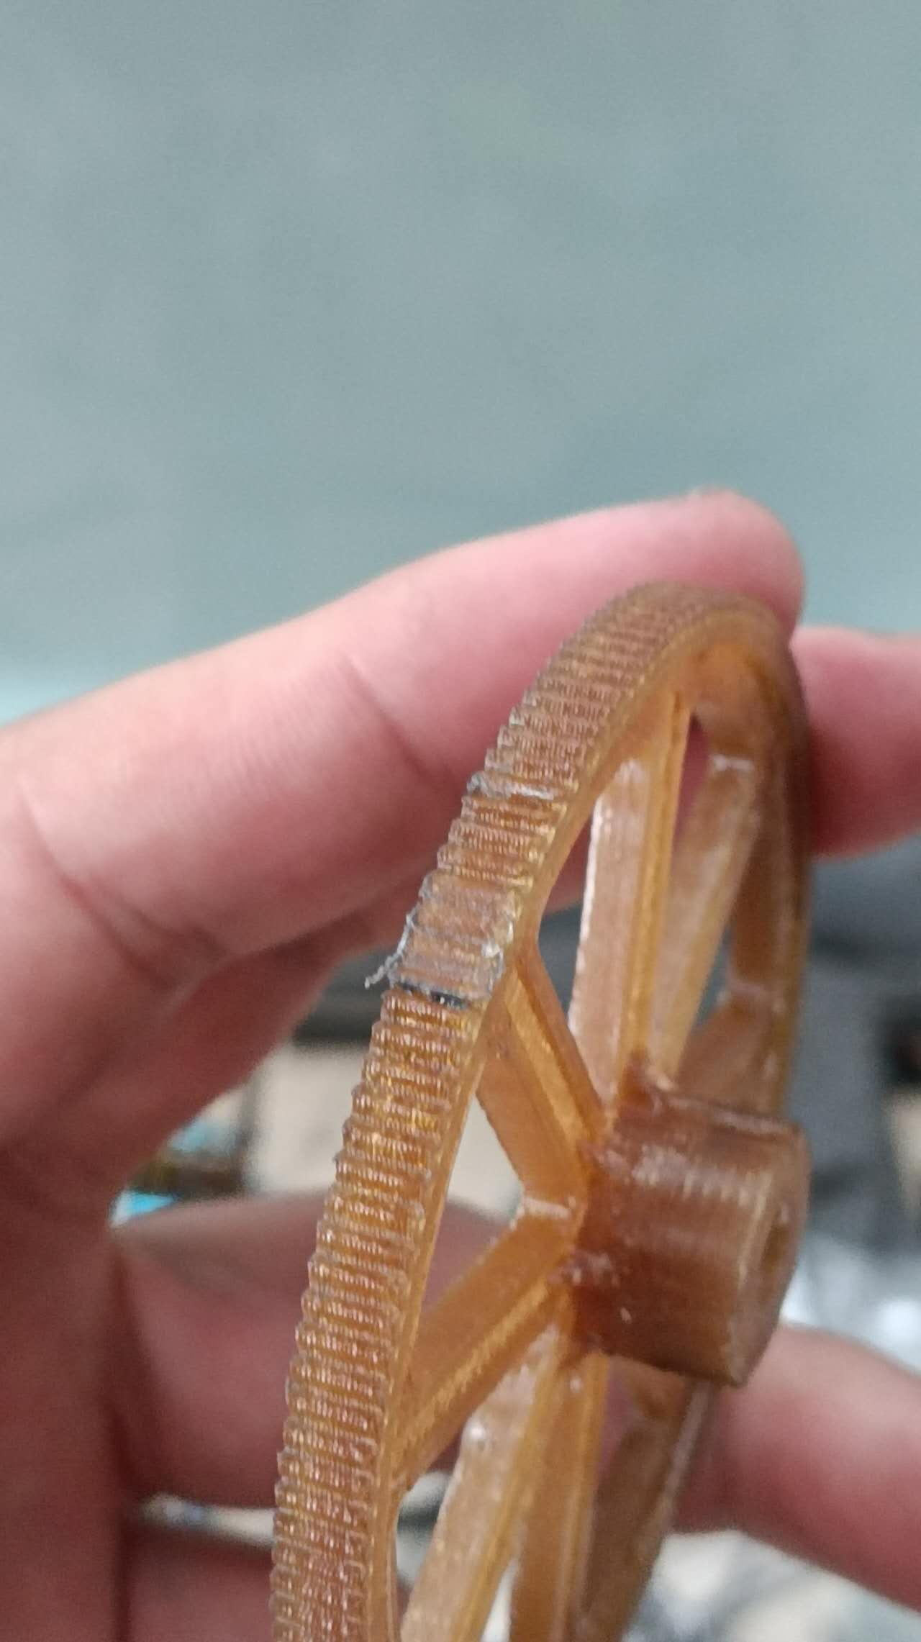
Research progress and problems encountered
Enlarged flapping amplitude
Left gear screw came of, damaged gear
Installed PID switch
Next step:
Finish gear replacement
Calibrate PID
5

Slide 7
Thank you!

